Slide 1
Database Concepts
2006
Prof. Yousef B. Mahdy

Slide 2
Entity-Relationship (ER)
Modeling
A bad workman never gets a good tool

Slide 3
What Is the Software Engineering Process?
The term "software engineering" refers to a process of specifying, designing, writing, delivering, maintaining, and finally retiring software. Some authors use the term "software engineering" synonymously with "systems analysis and design" and other titles, but the underlying point is that any information system requires some process to develop it correctly. Software engineering spans a wide range of information system problems. The problem of primary interest here is that of specifying a database. "Specifying a database" means that we will document what the database is supposed to contain.
A basic idea in software engineering is that to build software correctly, a series of steps (or phases) are required. The steps ensure that a process of thinking precedes action — thinking through "what is needed" precedes "what is written." Further, the "thinking before action" necessitates that all parties involved in software development understand and communicate with one another. One common version of presenting the thinking before acting scenario is referred to as a waterfall model, as the process is supposed to flow in a directional way without retracing.

Slide 4
An early step in the software engineering process involves specifying what is to be done. The waterfall model implies that once the specification of the software is written, it is not changed, but rather used as a basis for development. One can liken the software engineering exercise to building a house.
The specification is the "what do you want in your house" phase. Once agreed upon, the next step is design. As the house is designed and the blueprint is drawn, it is not acceptable to revisit the specification except for minor alterations. There has to be a meeting of the minds at the end of the specification phase to move along with the design (the blueprint) of the house to be constructed. So it is with software and database development.
Software production is a life-cycle process — it is created, used, and eventually retired. The "players" in the software development life cycle can placed into two camps, often referred to as the "user" and the "analyst." Software is designed by the analyst for the user according to the user's specification.
There is no general agreement among software engineers as to the exact number of steps or phases in the waterfall-type software development "model." Models vary, depending on the interest of the author in one part or another in the process .

Slide 5
very brief description of the software process
Step 1 (or Phase 1): Requirements. Find out what the user wants or needs.
Step 2: Specification. Write out the user wants or needs as precisely as possible.
  Step 2a: Feedback the specification to the user (a review) to see if the analyst (you) have it right.
  Step 2b: Re-do the specification as necessary and return to step 2a until analyst and user both understand one another and agree to move on.
Step 3: Software is designed to meet the specification from step 2.
  Step 3a: Software design is independently checked against the specification and fixed until the analyst has clearly met the specification. Note the sense of agreement in step 2 and the use of step 2 as a basis for further action. When step 3 begins, going back up the waterfall is difficult — it is supposed to be that way. Perhaps minor specification details might be revisited but the idea is to move on once each step is finished.
Step 4: Software is written (developed).
  Step 4a: Software, as written, is checked against the design until the analyst has clearly met the design. Note that the specification in step 2 is long past and only minor modifications of the design would be tolerated here.
Step 5: Software is turned over to the user to be used in the application.
  Step 5a: User tests and accepts or rejects until software is written correctly (it meets specification and design).
Step 6: Maintenance is performed on software until it is retired. Maintenance is a very time-consuming and expensive part of the software process — particularly if the software engineering process has not been done well. Maintenance involves correcting hidden software faults as well as enhancing the functionality of the software.

Slide 6
ER Diagrams and the Software Engineering Life Cycle
This lecture concentrates on steps 1 through 3 of the software life cycle for database modelling. A database is a collection of related data. The concept of related data means that a database stores information about one enterprise - a business, an organization, a grouping of related people or processes. Again, a database is a collection of related data.
Database systems are often modelled using an Entity Relationship (ER) diagram as the "blueprint" from which the actual data is stored - the output of the design phase. The ER diagram is an analyst's tool to diagram the data to be stored in an information system. Step 1, the requirements phase, can be quite frustrating as the analyst must elicit needs and wants from the user. The user may or may not be computer-sophisticated and may or may not know a software system's capabilities. The analyst often has a difficult time deciphering needs and wants to strike a balance of specifying something realistic.
In the real world, the "user" and the "analyst" can be committees of professionals but the idea is that users (or user groups) must convey their ideas to an analyst (or team of analysts) - users must express what they want and think they need.
User descriptions are often vague and unstructured. We will present a methodology that is designed to make the analyst's language precise enough so that the user is comfortable with the to-be-designed database, and the analyst has a tool that can be mapped directly into a database.

Slide 7
The early steps in the software engineering life cycle for databases
Step 1: Getting the requirements. Here, we listen and ask questions about what the user wants to store. This step often involves letting users describe how they intend to use the data that you (the analyst) will load into a database. There is often a learning curve necessary for the analyst as the user explains the system they know so well to a person who is ignorant of their specific business.
Step 2: Specifying the database. This step involves grammatical descriptions and diagrams of what the analyst thinks the user wants. Because most users are unfamiliar with the notion of an Entity-Relationship diagram (ERD), our methodology will supplement the ERD with grammatical descriptions of what the database is supposed to contain and how the parts of the database relate to one another. The technical description of the database is often dry and uninteresting to a user; however, when analysts put what they think they heard into statements, the user and the analyst have a "meeting of the minds." For example, if the analyst makes statements such as, "All employees must generate invoices," the user may then affirm, deny, or modify the declaration to fit what is actually the case.
Step 3: Designing the database. Once the database has been diagrammed and agreed-to, the ERD becomes the blueprint for constructing the database.

Slide 8
Database development activities during SDLC
Project Identification
and Selection
Enterprise modeling
Project Initiation
and Planning
Conceptual data modeling
Analysis
Logical db design
Logical Design
Physical db design
Physical Design
DB implementation
Implementation
Maintenance
DB maintenance

Slide 9
Database Design
Process of developing data structures from user requirements:
    logical structure
    physical structure
GOALS:
  information content requirements
  natural and easy-to-understand
  processing and performance requirements

Slide 10
Database Design Steps
Proj.Scope
Requirements Collection
and Analysis
Internal Schema
DB Requirements
Conceptual Design
Physical Design
Conceptual Schema
(in high-level data model
E.g. ER model)
Conceptual Schema
(in DBMS specific data model
e.g. relational model)
Logical Design
DBMS-independent
DBMS specific

Slide 11
I. Requirements Analysis
  Purpose: identify/describe data required by users
  Input: Functional and Data requirements
  Output: User specifications
II. Conceptual Design
  Purpose: synthesize diff. users' views to global database design
  Input: User requirements from (I) & functional requirements
  Output: high-level data model
III. Logical Design (implementation design)Purpose: to map conceptual design into specific DBMS
Physical Design
Purpose: Concerned with factors relating to performance
III. Logical Design (implementation design)
    Purpose: to map conceptual design into specific DBMS
IV. Physical Design
    Purpose: Concerned with factors relating to performanc

Slide 12
Conceptual Modeling
Objective: to produce HIGH-LEVEL DATA MODEL
GOALS
  a complete understanding of the database structure, meaning (semantics), interrelationships, and constraints
  A stable description of the database contents
  Usually more expressive and general than data models of individual DBMSs
  Vehicle of communication among database users, designers, and analysts.

Slide 13
Qualities of Conceptual Data Model
Expressiveness
  Able to distinguish different types of data, relationships and constraints
Simplicity
  Simple enough for non-specialist users to understand and use its concepts
Minimality
  Have a small number of basic concepts that are distinct and non-overlapping in meaning
Formality
  Formal, accurate & unambiguous specification of data

Slide 14
Understanding Business Rules and Objectives
You can create a beautifully appropriate database model with clearly defined objects, using a set of clearly defined database design methodological steps. Elegant solutions, however, must be practical and useful.
You must understand that you are designing for practical application, not elegance, and the most elegant solution is not always the most practical. The importance of understanding the nature of the business is paramount to understanding how best to model that business in a database.
Some of the operational aspects of a business will be built into a database model design, even into the bare structure itself in the form of the tables and the relationships between those tables.
This discussion leads to the sometimes sorely misunderstood topic called business rules. The term “business rules” is often open to interpretation as to exactly what it means.
A relational database model allows the implementation of the most significant business rules into its basic structure. That basic structure is the relationships between tables. Business rules are applied by enforcing the validity of those relationships.

Slide 15
Business Rules
Business rules for an organization are essentially the processes and flows of whatever is involved in the daily workings of that organization—in other words, the operation of that business and the decisions made to execute the operational processes of that organization. What does the organization do to operate? What is its task? What is the meaning and purpose of its existence? How does it make its money? Hopefully, it does turn a profit.
Business rules essentially have great scope for definition and redefinition, even in a single organization. Essentially, business rules cover the following aspects of an organization:
  Any types of organizational policies of any form and at all levels of the organization
  Any types of calculations or formulas (such as loan amortization calculations for a mortgage lending company)
  Any types of regulations (such as rules applied because of legal requirements, self-imposed
  restrictions, or industry-standard requirements)
Statements that define or constrain some aspect of the business
Assert business structure
Control/influence business behavior
Expressed in terms familiar to end users
Automated through DBMS software

Slide 16
A Good Business Rule is:
Declarative – what, not how
Precise – clear, agreed-upon meaning
Atomic – one statement
Consistent – internally and externally
Expressible – structured, natural language
Distinct – non-redundant
Business-oriented – understood by business people

Slide 17
The Relational Model
The relational model is based on a collection of mathematical principles drawn primarily from set theory and predicate logic. These principles were first applied to the field of data modeling in the late 1960s by Dr. E. F. Codd, then a researcher at IBM, and first published in 1970.
The relational model defines the way data can be represented (data structure), the way data can be protected (data integrity), and the operations that can be performed on data (data manipulation).
The entire structure is, as we've said, a relation, n-ary relations, to be precise. An n-ary relation can be pictured as a table with n columns; the columns in the picture correspond to attributes of the relation and the rows correspond to tuples. Each row of data is a tuple. Actually, each row is an n-tuple, but the "n-" is usually dropped. The number of tuples in a relation determines its cardinality. In this case, the relation has a cardinality of 11. Each column in the tuple is called an attribute. The number of attributes in a relation determines its degree. The example relation has a degree of 3.
Relations are defined over types (also known as domains); a type is basically a conceptual pool of values from which actual attributes in actual relations take their actual values.

Slide 18
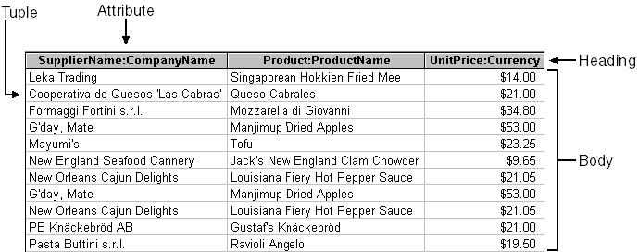
The relation is divided into two sections, the heading and the body. The tuples make up the body, while the heading is composed of, well, the heading. Note that the label for each attribute is composed of two terms separated by a colon—for example, UnitPrice:Currency. The first part of the label is the name of the attribute, while the second part is its domain. The domain of an attribute is the "kind" of data it represents—in this case, currency. The specification of domain is often dropped from the heading.

Slide 19
The Relational Model
The body of the relation consists of an unordered set of zero or more tuples. There are some important concepts here:
  First, the relation is unordered. Record numbers do not apply to relations. Relations have no intrinsic order.
  Second, a relation with no tuples (an empty relation) still qualifies as a relation.
  Third, a relation is a set. The items in a set are, by definition, uniquely identifiable.
Therefore, for a table to qualify as a relation, each record must be uniquely identifiable and the table must contain no duplicate records.
If you've read the Access or SQL Server documentation, you might be wondering why you've never seen any of these words before. They're the formal terminology used in the technical literature.
Remember that relations are purely conceptual; once instantiated in the database, they become recordsets in Microsoft Jet and result sets in SQL Server, while for both Microsoft Jet and SQL Server an attribute becomes a field and a tuple becomes a record.
The correspondences are pretty much one-to-one, but remember that relations are conceptual and recordsets and result sets are physical.

Slide 20
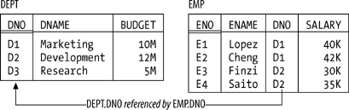
The Relational Model
The relational model also supports various kinds of keys. To begin with, every relation has at least one candidate key. A candidate key is just a unique identifier; in other words, it's a combination of attributes (one or more) such that every tuple in the relation has a unique value for the combination in question. In Figure, for example, every department has a unique department number and every employee has a unique employee number, so we can say that {DNO} is a candidate key for DEPT and {ENO} is a candidate key for EMP.

Slide 21
The Relational Model
Next, a primary key is a candidate key that's been singled out for special treatment in some way. If a given relation has just one candidate key, then it obviously makes no real difference if we say it's the primary key. But if the relation has two or more candidate keys, then we're supposed to choose one of them as primary. Suppose, for example, that every employee has a unique employee number and a unique employee name, so that {ENO} and {ENAME} are both candidate keys for EMP. Then we might choose {ENO}, say, to be the primary key.
Finally, a foreign key is a set of attributes in one relation whose values are required to match the values of some candidate key in some other relation (or possibly in the same relation). With reference to the above Figure , for example, {DNO} is a foreign key in EMP whose values are required to match values of the candidate key {DNO} in DEPT. By required to match, I mean that if, for example, EMP includes a tuple in which DNO has the value D2, then DEPT had better also include a tuple in which DNO has the value D2; otherwise, EMP would show some employee as being in a nonexistent department, and the database wouldn't be "a faithful model of reality."

Slide 22
Integrity Features
An integrity constraint (constraint for short) is basically just a boolean expression that must evaluate to TRUE. In the case of departments and employees, for example, we might have a constraint to the effect that SALARY values must be greater than zero. Now, any given database will be subject to numerous constraints, but those constraints will necessarily be expressed in terms of the relations in that particular database and will be specific to that database. By contrast, the relational model (at least as originally formulated) includes two generic integrity rules—generic in the sense that they apply to every database, loosely speaking. One has to do with primary keys and the other with foreign keys:
Entity integrity
  Primary key attributes don't permit nulls.
Referential integrity
  There mustn't be any unmatched foreign key values.

Slide 23
The Relational Model
Let me explain the second first. By the term unmatched foreign key value, I mean a foreign key value for which there doesn't exist an equal value of the corresponding candidate key. Thus, for example, the departments-and-employees database would be in violation of the referential integrity rule if it included an EMP tuple with, say, a DNO value of D2 but no corresponding DEPT tuple. So the referential integrity rule simply spells out the semantics of foreign keys; the name referential integrity derives from the fact that any given foreign key value can be regarded as a reference to the tuple with that same value for the corresponding candidate key. In effect, therefore, the rule just says: "If B references A, then A must exist.“

Slide 24

The Relational Model
In essence, then, a null is a "marker" that means value unknown (crucially, it's not itself a value; it is, to repeat, a marker, or flag). For example, suppose we don't know employee E2's salary. Then, instead of entering some real SALARY value in the tuple for that employee in relation EMP—we can't enter a real value, by definition, precisely because we don't know what that value should be—we mark the SALARY position within that tuple as null.
As you can see, this tuple contains nothing at all in the SALARY position. In terms of relation EMP, then, the entity integrity rule says, loosely, that an employee might have an unknown name, department, or salary, but not an unknown employee number—because if the employee number were unknown, we wouldn't even know which employee (that is, which "entity") we were talking about.

Slide 25
Manipulative Features
The manipulative part of the model consists of:
A set of relational operators, such as difference (or MINUS), collectively called the relational algebra.
  As for the relational algebra, it consists of a set of operators that allow "new" relations to be derived from "old" ones (speaking very loosely). More precisely, each operator takes at least one relation as input and produces another relation as output; for example, difference (or MINUS) takes two relations as input and "subtracts" one from the other to derive another relation as output. And it's very important that the output is another relation: that's the well-known closure property of the relational algebra.
  The closure property is what lets us write nested relational expressions; since the output from every operation is the same kind of thing as the input, the output from one operation can become the input to another—meaning, for example, that we can take the difference between r and s, feed the result as input to a union with some relation u, feed that result as input to an intersection with some relation v, and so on.
A relational assignment operator that allows the value of some relational expression, such as r MINUS s (where r and s are relations), to be assigned to some relation. The relational assignment operator is fundamentally how updates are done in the relational model.

Slide 26
The Running Example
I'll finish up this brief review by introducing the example : the well-known suppliers-and-parts database (see Figure ). To elaborate:
Suppliers
  Relation S denotes suppliers (more accurately, suppliers under contract). Each supplier has one supplier number (SNO), which is unique to that supplier (and so {SNO} is the primary key); one name (SNAME), not necessarily unique; one rating or status value (STATUS); and one location (CITY).
Parts
  Relation P denotes parts (more accurately, kinds of parts). Each kind of part has one part number (PNO), which is unique (so {PNO} is the primary key); one name (PNAME); one color (COLOR); one weight (WEIGHT); and one location where parts of that kind are stored (CITY).
Shipments
  Relation SP denotes shipments (it shows which parts are supplied by which suppliers). Each shipment has one supplier number (SNO), one part number (PNO), and one quantity (QTY). For the sake of the example, I assume there's at most one shipment at any given time for a given supplier and a given part (and so {SNO,PNO} is the primary key; also, {SNO} and {PNO} are both foreign keys, matching the primary keys of S and P, respectively). Note that the database shown in includes one supplier, supplier S5, with no shipments at all.

Slide 27
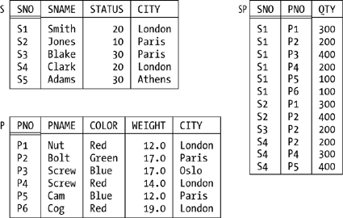
The Running Example

Slide 28
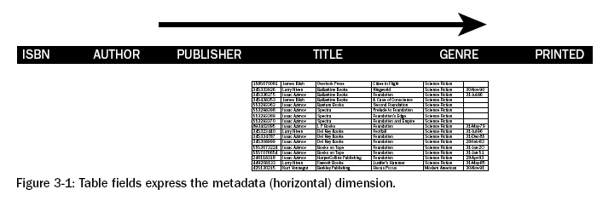
Understanding the Basics of Tables
In data model theory, a table is a bucket into which data is poured. The idea of the relational database model and normalization is that data in a specific table is directly associated with all other items in that same table—that would be each field as shown in Figure, pictured as the horizontal dimension.

Slide 29
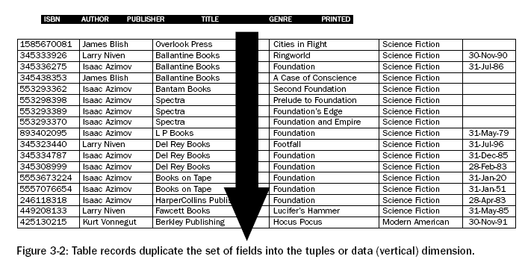
Tables:
Records are repeated over and over again in the vertical dimension, duplicating field structures from the horizontal dimension, as exaggerated in Figure 3-2.

Slide 30
Tables:
A table is effectively a structure containing fields across it in one dimension defining the structure of records repeatedly added to that table. In other words, all records in the same tables have the same field structure applied to them.
The following figure shows a picture demonstrating a pile of books on the left, passed through a table structure represented by the miniature ERD in the centre, resulting in the structured data set on the right.

Slide 31
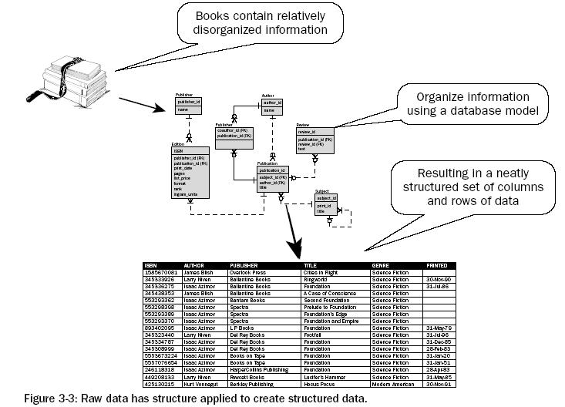

Slide 32
Records, Rows, and Tuples
The terms record, row, and tuple all mean the same thing. They are terms used to describe a record in a table.
The following figure shows the structure of fields applied to each record entry in a table. There is really nothing to understand other than that a table can have multiple fields, whereas that set of fields can have many records created in that table, and data can subsequently be accessed according to the field structure of the table, record by record.

Slide 33
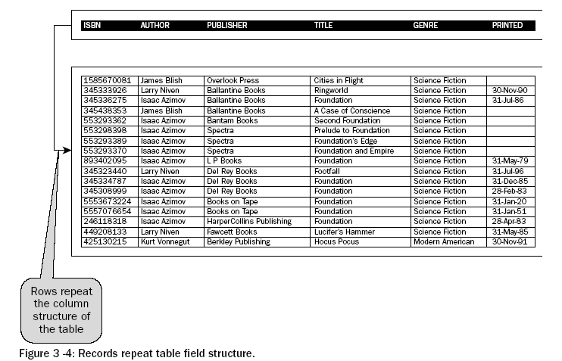
Records, Rows, and Tuples

Slide 34
Fields, Columns and Attributes
The terms field, column, and attribute all mean the same thing. They are all terms used to describe a field in a table. A field applies structure and definition to a chunk of data within each repeated record. Figure
Data is not actually repeated on every record, but the structure of fields is applied to each record. So, data on each record can be different, both for the record as a whole, and for each field value. Note the use of the term “can be” rather than “is,” implying that there can be duplication across both fields and records, depending on requirements and constraints. A constraint constrains (restricts) a value.
The left column shows the name of fields in the table. This particular table is used to contain separate editions of the same book. Separate editions of a single book can each be published by different publishers. Thus, the PUBLISHER_ID field is included in the EDITION table. Note various other fields such as the PUBLICATION_ID field - uniquely identifying a unique book name, which is stored in the PUBLICATION table. The PUBLICATION table represents each book uniquely regardless of the existence of multiple editions of the same title or not. The International Standard Book Number (ISBN) uniquely identifies a book on an international basis, and is distinct for each edition of a book.
Data types are shown as INTEGER, DATE, or VARCHAR(32). These three field types restrict values to be of certain content and format. INTEGER only allows whole numbers, all characters consisting of digits between 0 and 9, with no decimal point character. DATE only allows date entries where specific formatting may apply. Most databases will have a default format for date values.
Effectively, data types can constrain values in fields in a similar way to that of the previously specified NOT NULL constraint does. Similar to constraints, data types can restrict values, so data types are also a form of field value constraining functionality.

Slide 35
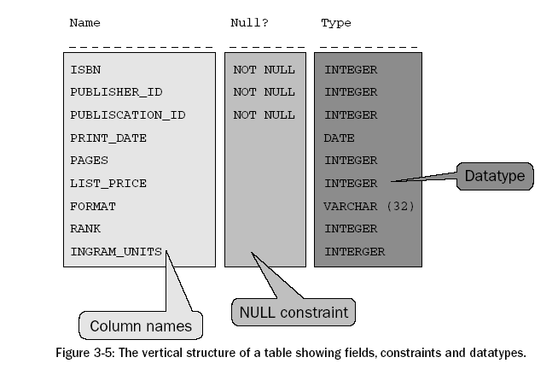

Slide 36
What Is an Entity Relationship (ER) Diagram?
The ER diagram is a semantic data modeling tool that is used to accomplish the goal of abstractly describing or portraying data. Abstractly described data is called a conceptual model. Our conceptual model will lead us to a "schema."
A schema implies a permanent, fixed description of the structure of the data. Therefore, when we agree that we have captured the correct depiction of reality within our conceptual model, our ER diagram, we can call it a schema.
The Entity-Relationship model is a set of concepts and graphical symbols that can be used to create conceptual schemas
Developed by Peter Chen of M.I.T. in 1976 in a landmark paper, "The Entity-Relationship Model: Toward a Unified View of Data," ACM Transactions on Database Systems, Vol. 1, No. 1
Chen's initial model has been refined over the years

Slide 37
The Four Major Components of the Entity Relationship (E-R) Model
  Entities (really entity sets)
  Attributes
  Relationships
  Identifiers
As the name implies, an ER diagram models data as entities and relationships, and entities have attributes. An entity is a thing about which we store data, for example, a person, a bank account, a building. In the original presentation, Chen (1976) described an entity as a "thing which can be distinctly identified." So an entity can be a person, place, object, event, or concept about which we wish to store data.\
The name for an entity must be one that represents a type or class of thing, not an instance.
Some examples of entities include:
  Examples of a person entity would be EMPLOYEE, VET, or STUDENT.
  Examples of a place entity would be STATE or COUNTRY.
  Examples of an object entity would be BUILDING, AUTO, or PRODUCT.
  Example of an event entity would be SALES, RETURNS, or REGISTRATION.
  Examples of a concept entity would be ACCOUNT or DEPARTMENT.
In a database context, it is unusual to store information about one entity, so we think of storing collections of data about entities — such collections are called entity sets. Entity sets correspond to the concept of "files," but again, a file usually connotes a physical entity and hence we abstract the concept of the "file" (entity set) as well as the concept of a "record" (entity). As an example, suppose we have a company that has customers. You would imagine that the company had a customer entity set with individual customer entities in it.

Slide 38
E-R Model
When we speak of capturing data about a particular entity, we refer to this as an instance. An entity instance is a single occurrence of an entity. For example, if we create an entity called TOOL, and if we choose to record data about a screwdriver, then the screwdriver "record" is an instance of TOOL. Each instance of an entity must be uniquely identifiable so that each instance is separate and distinctly identifiable from all other instances of that type of entity. In a customer entity set, you might imagine that the company would assign a unique customer number, for example. This unique identifier is called a key.
A relationship is a link or association between entities. Relationships are usually denoted by verb phrases.
An attribute is a property or characteristic for an entity. For example, an entity, AUTOMOBILE, may have attributes type, color, vehicle_id, etc.

Slide 39
E-R Model Constructs
Entity instance - person, place, object, event, concept (often corresponds to a row in a table)
Entity Type – collection of entities (often corresponds to a table)
Attribute - property or characteristic of an entity type (often corresponds to a field in a table)
Relationship instance – link between entities (corresponds to primary key-foreign key equivalencies in related tables)
Relationship type – category of relationship…link between entity types
Notes:
2

Slide 40
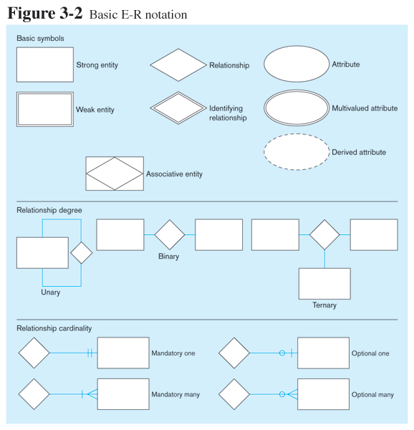
Relationship symbols
Entity symbols
Attribute symbols
A special entity that is also a relationship
Relationship degrees specify number of entity types involved
Relationship cardinalities specify how many of each entity type is allowed
Notes:
8

Slide 41
What Should an Entity Be?
SHOULD BE:
  An object that will have many instances in the database
  An object that will be composed of multiple attributes
  An object that we are trying to model
SHOULD NOT BE:
  A user of the database system
  An output of the database system (e.g. a report)

Slide 42
Attributes
Attributes are characteristics of entities that provide descriptive details about the entities. There are several different kinds of attributes: simple or atomic, composite, multi-valued, and derived.
The properties of an attribute are its name, description, format, and length, in addition to its atomiticity. Some attributes may be considered unique identifiers for an entity.
Attribute
  Property of an entity
  Value from corresponding value set
  Simple versus composite
    Simple attributes are atomic
      E.g. tel#; part-color; basic-salary;
    Composite attributes made up of simple attributes
      E.g., address = (apt#, block#, road name, postal code)
Notes:
5

Slide 43
Attributes
Attribute
  Single valued versus multivalued
    Single valued: single value associated with an attribute
    Multivalued: may have more than one values
      E.g., University degree attribute may contain B.Eng., M.Eng., or Ph.D.
  Stored versus derived
    Most attribute values are stored
    Derived from stored value
      E.g., age from birthdate
Date of Birth
AGE

Slide 44
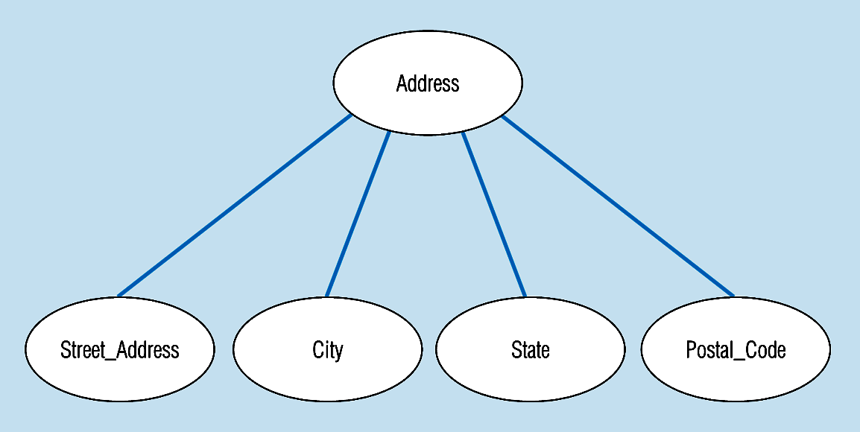
A composite attribute
An attribute broken into component parts
Notes:
12

Slide 45
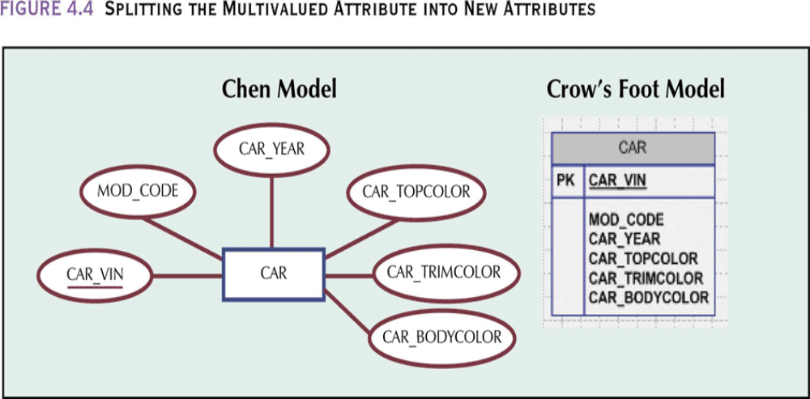
Resolving Multivalued Attribute Problems
Although the conceptual model can handle multivalued attributes, you should not implement them in the relational DBMS
  Within original entity, create several new attributes, one for each of the original multivalued attribute’s components
    Can lead to major structural problems in the table
  Create a new entity composed of original multivalued attribute’s components

Slide 46
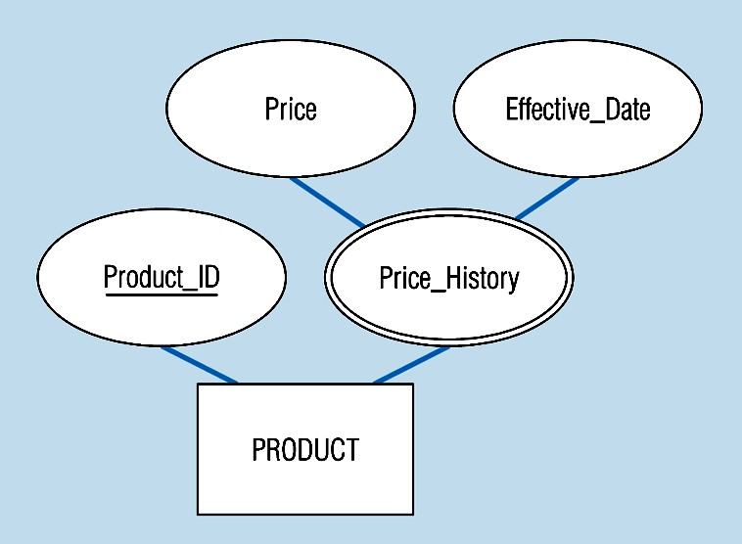
An attribute that is both multivalued and composite
This is an example of time-stamping
Notes:
37

Slide 47
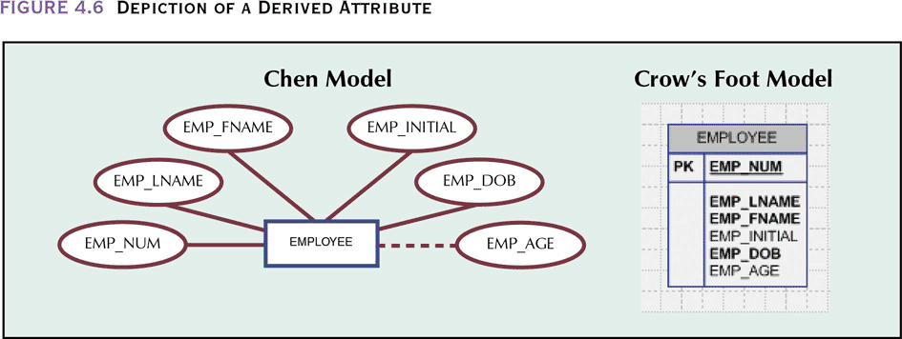
Derived Attributes
Attribute whose value may be calculated (derived) from other attributes
Need not be physically stored within the database
Can be derived by using an algorithm

Slide 48
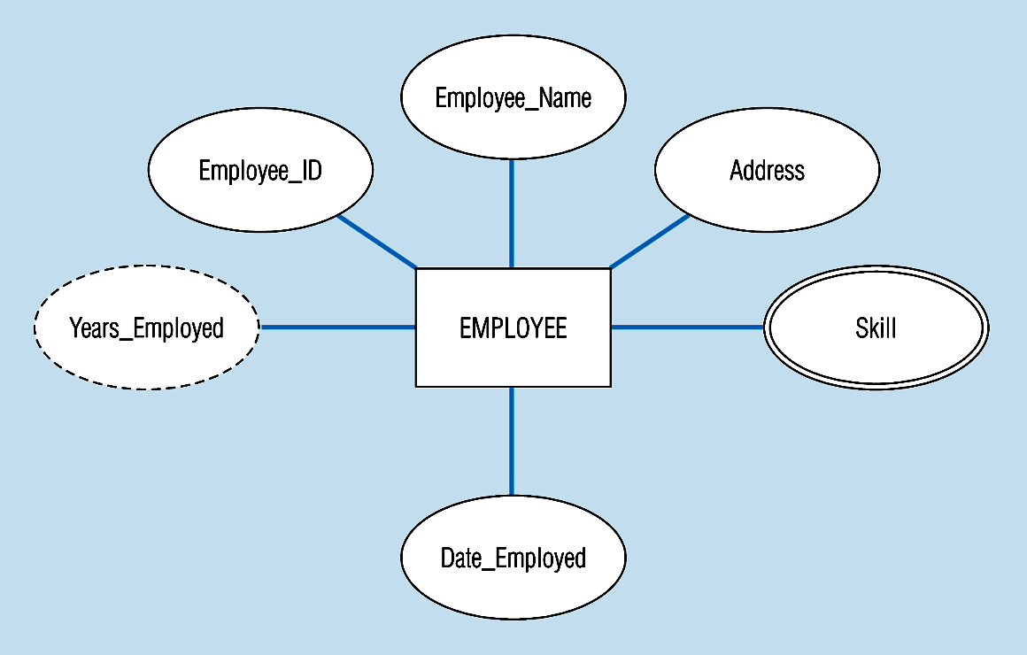
Entity with a multivalued attribute (Skill) and derived attribute (Years_Employed)
What’s wrong with this?
Derived
from date employed and current date
Multivalued:
an employee can have
more than one skill
Notes:
13

Slide 49
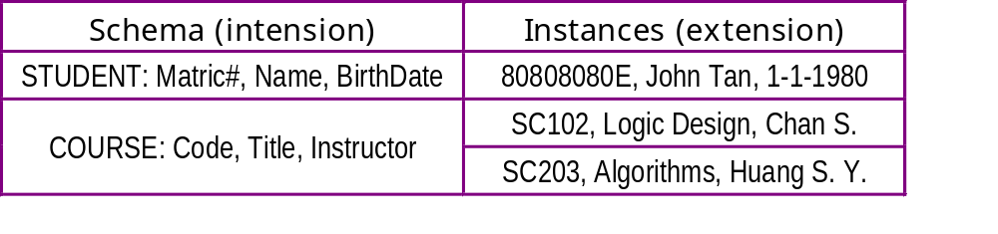

! Don’t confuse Instance with Type
Entity type
  A set of entities with same attributes
  It is a schema or intension for a set of entities sharing the same structure
Alpha, 1st Jan.'96, 25kg
Beta, 2nd Feb. '96, 28kg
Omega, 3rd Mar.'96, 21kg
CHILD: Name
Date-of-birth
Weight

Slide 50

Key attribute
  An attribute whose value is unique for each entity
    E.g., Matric# is key of STUDENT entity type
  Some entity types may have more than one key attributes
    E.g., STUDENT may be identified by Matric# or Student# or IC#
  Key can be composite attribute
    E.g., CarReg# can be (CarPlate#, State)

Slide 51
Identifiers (Keys)
Identifier (Key) - An attribute (or combination of attributes) that uniquely identifies individual instances of an entity type
Simple Key versus Composite Key
Candidate Key – an attribute that could be a key…satisfies the requirements for being a key
Characteristics of Identifiers:
  Will not change in value
  Will not be null
  No intelligent identifiers (e.g. containing locations or people that might change)
  Substitute new, simple keys for long, composite keys
Notes:
6

Slide 52

Simple key attribute
The key is underlined
Notes:
14

Slide 53
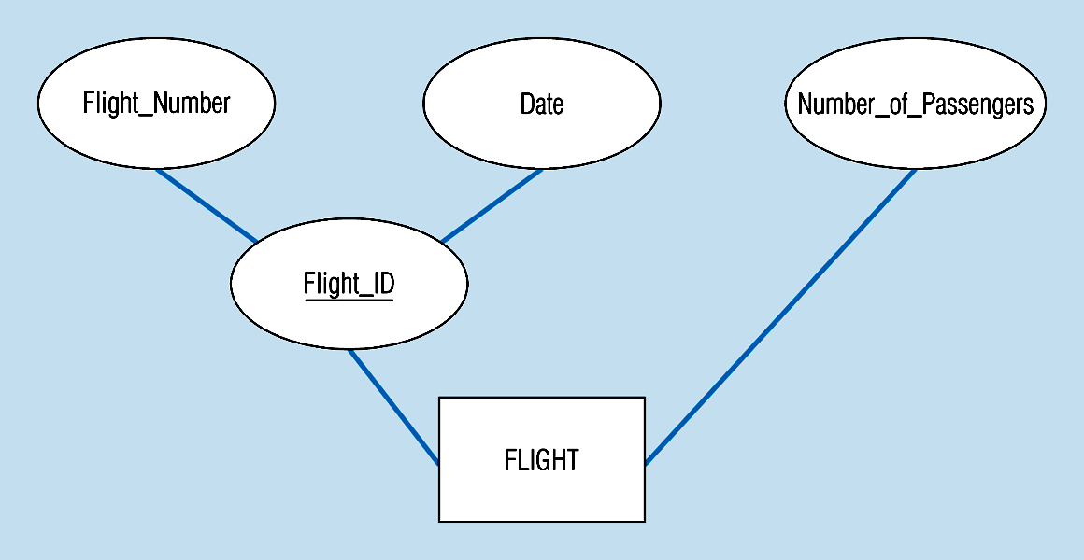
Composite key attribute
The key is composed
of two subparts
Notes:
15

Slide 54
Relationship
Relationship
  An association among entities
    E.g., John Lee is registered for SC304; Dewey is a dependent of Donald Duck

Slide 55
Relationships
Association between entities
Participants:
  Entities that participate in a relationship
Relationships between entities always operate in both directions
Relationship can be classified as 1:M
Relationship classification is difficult to establish if you only know one side
Degree of a relationship is the number of entity types that participate in it
  Unary Relationship
  Binary Relationship
  Ternary Relationship
Connectivity
  Used to describe the relationship classification
Cardinality
  Expresses the specific number of entity occurrences associated with one occurrence of the related entity
Established by very concise statements known as business rules

Slide 56
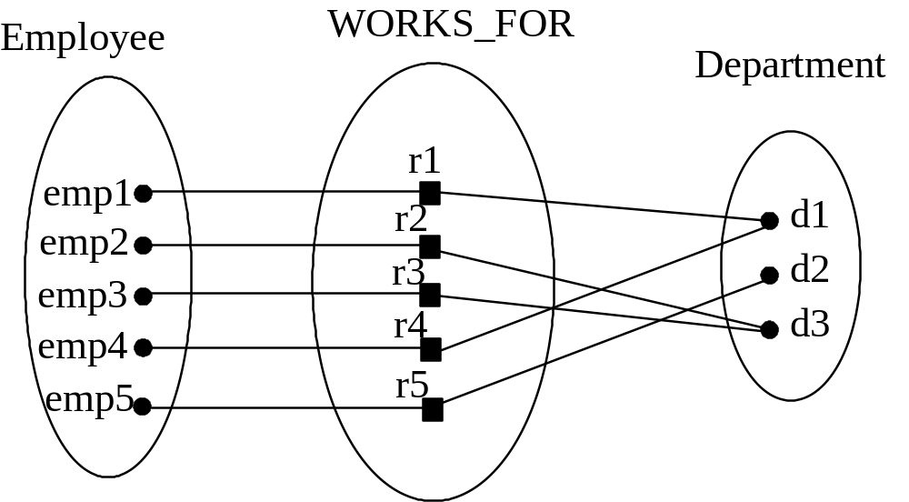
Relationship type
  A set of relationships of the same type
  Example of WORKS_FOR relationship between EMPLOYEE entity type and DEPARTMENT entity type
Each instance r must relate one employee to one dept.

Slide 57
Degree
  No. of participating entity types
  Degree 2 is called binary; Works_for is binary relationship; degree 3 is called ternary
  Example of ternary relationship:
EMPLOYEE
ASSIGNED_TO
e₁
r₁
DEPARTMENT
e₂
e₃
r₂
d₁
.
.
.
r₃
d₂
.
.
.
.
.
.
p₁
Each instance of r must
be associated with 3 objects
p₂
.
.
.
PROJECT

Slide 58
Degree of relationships
Entities of two different types related to each other
One entity related to another of the same entity type
Entities of three different types related to each other
Notes:
8

Slide 59
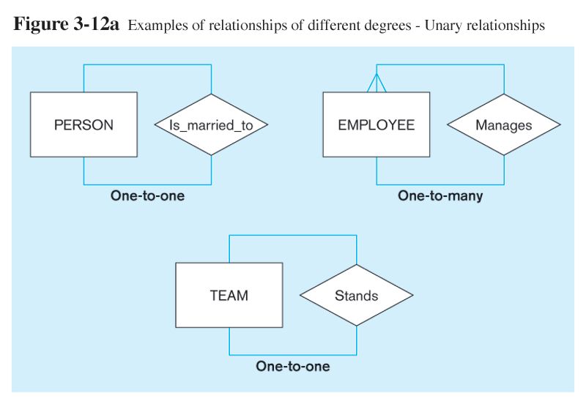
Notes:
22

Slide 60
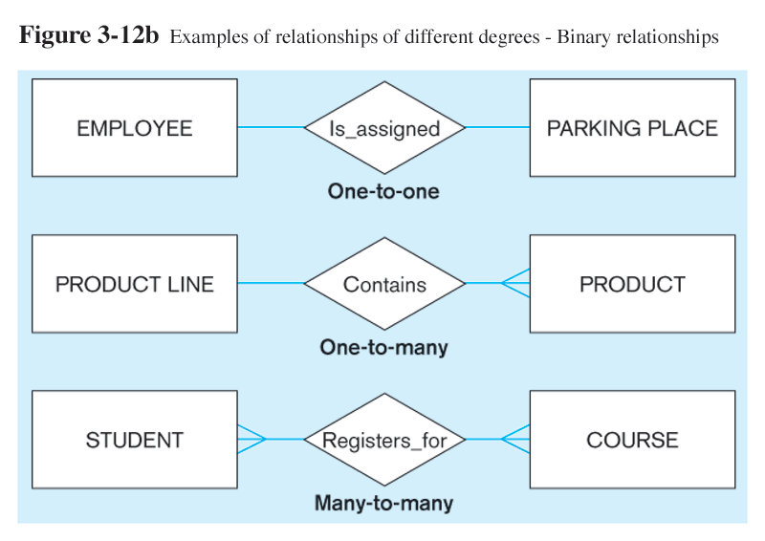
Notes:
23

Slide 61
To generalise: An n-ary relationship set R relates n entity types E₁, E₂, …, E_{n}; R is a subset of {(e₁,e₂,…,e_{n}) | e₁∈E₁, e₂∈E₂, …, e_{n}∈E_{n}}; relationship instance is (e₁,e₂,…,e_{n})
Structural constraints (on entities in a relationship type)
  Cardinality ratio
    No. of relationship instances that an entity can participate
    Possible cardinality ratios for binary relationships are 1:1, 1:N, N:M

Slide 62
Cardinality of Relationships
One-to-One
  Each entity in the relationship will have exactly one related entity
One-to-Many
  An entity on one side of the relationship can have many related entities, but an entity on the other side will have a maximum of one related entity
Many-to-Many
  Entities on both sides of the relationship can have many related entities on the other side
Cardinality Constraints - the number of instances of one entity that can or must be associated with each instance of another entity
  Minimum Cardinality
    If zero, then optional
    If one or more, then mandatory
  Maximum Cardinality
    The maximum number

Slide 63
EMPLOYEE
DEPARTMENT
EMPLOYEE
PROJECT
e₁
e₂
r₁
d₁
e₃
r₂
d₂
e₁
r₁
p₁
e₄
r₃
d₃
e₂
r₂
p₂
e₅
r₄
.
.
.
e₃
r₃
p₃
.
.
.
r₅
r₄
.
.
.
.
.
.
.
.
.
r₅
.
.
.
WORKS-FOR
ASSIGNED-TO
Each Employee
participates in one
instance of r
Each Department
may participate
in one or more
instance of r
EXAMPLE OF N:M
relationship
Example of 1:M relationship

Slide 64
Participation constraints
  TOTAL PARTICIPATION.
    Existence dependency : Entity exists only when it participates in a relationship. (see pg 28)
EMPLOYEE
SUPPORTS
DEPENDENT
e₁
e₂
r₁
d₁
e₃
r₂
d₂
e₄
r₃
d₃
.
.
.
.
.
.
e₅
.
.
.
Every DEPENDENT must participate in SUPPORTS

Slide 65
Partial dependency: Entity may or may not participate in a relationship
For example, MANAGES has partial participation of EMPLOYEE and total participation of DEPARTMENT
EMPLOYEE
MANAGES
DEPARTMENT
e₁
e₂
r₁
d₁
e₃
r₂
d₂
e₄
r₃
d₃
.
.
.
.
.
.
e₅
.
.
.
Every Dept has
a manager
Not every Employee
is a manager

Slide 66
ER NOTATION
Attribute
Entity type
Key attribute
Weak entity type
Multivalued attribute
Relationship type
Derived attribute
Identifying
Relationship type
Composite attribute

Slide 67
Cardinality ratio N:1
Total participation of EMPLOYEE in WORKS_FOR
WORKS-
FOR
EMPLOYEE
DEPARTMENT
N
1
Cardinality ratio N:M
Partial participation of EMPLOYEE in ASSIGNED_TO
EMPLOYEE
ASSIGNED-TO
PROJECT
N
M
Cardinality ratio 1:1
EMPLOYEE
MANAGES
DEPARTMENT
1
1

Slide 68
(min,max)
Structural constraint
(min, max) on
participation of E in R
R
E
(1,1)
WORK_
FOR
(5,N)
EMPLOYEE
DEPARTMENT
(1,N)
SUPERVISES
(0,1)
PROFESSOR
STUDENT
(1,N)
(1,N)
TUTORS

Slide 69
Recursive relationships
  Entity type participates more than once in relationship
    E.g., relationship SUPERVISE between two employees where entity type is EMPLOYEE; role names distinguish both employees are supervisor and supervisee
1
supervisor
EMPLOYEE
SUPERVISES
N
supervisee

Slide 70
Recursive Relationships
Relationship can exist between occurrences of the same entity set
Naturally found within a unary relationship

Slide 71
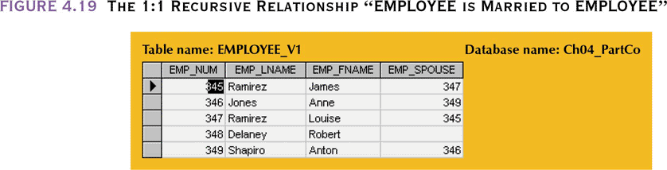
The 1:1 Recursive Relationship “EMPLOYEE is Married to EMPLOYEE”

Slide 72
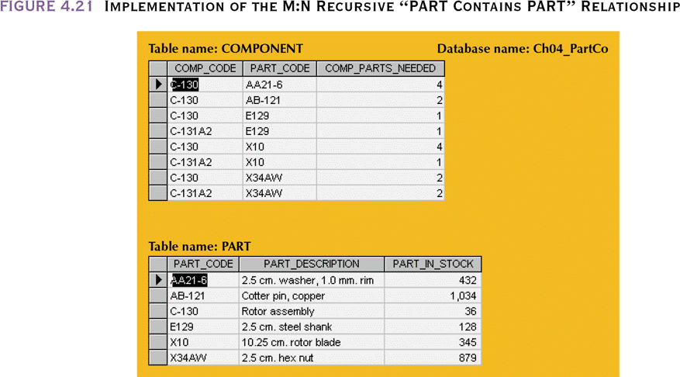
Implementation of the M:N Recursive “PART Contains PART” Relationship

Slide 73
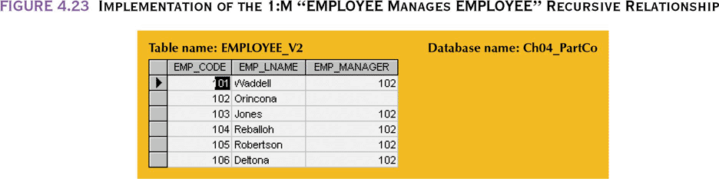
Implementation of the 1:M “EMPLOYEE Manages EMPLOYEE” Recursive Relationship

Slide 74
Attributes of relationship
  Relationships may have attributes
    E.g., WORKS_ON relationship between EMPLOYEE and PROJECT may have hour as attribute
N
WORK_
ON
M
EMPLOYEE
PROJECT
hour
"hour" indicates the no. of hours spent by Employee X on
Project Y

Slide 75
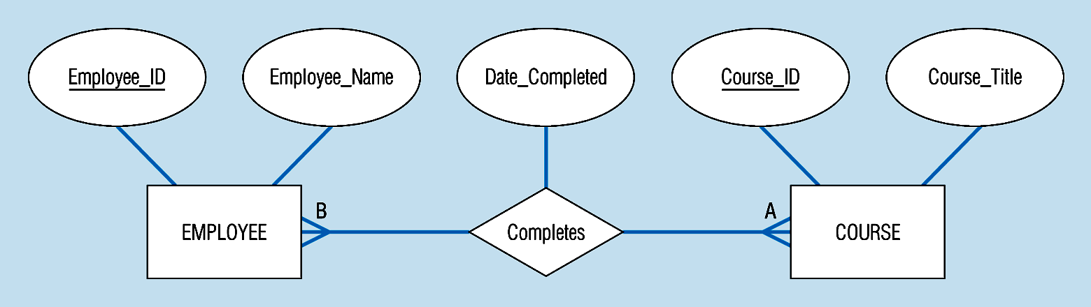
A binary relationship with an attribute
Here, the date completed attribute pertains specifically to the employee’s completion of a course…it is an attribute of the relationship
Notes:
20

Slide 76
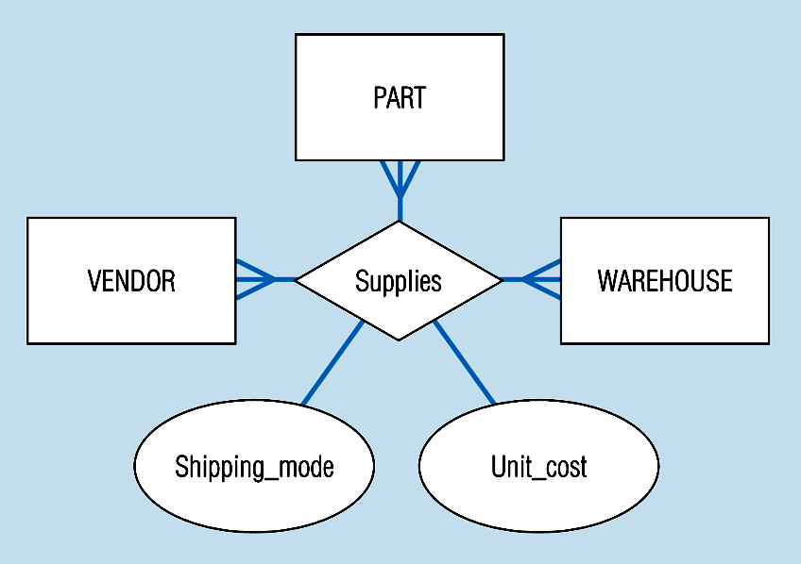
A ternary relationship with attributes
Notes:
24

Slide 77
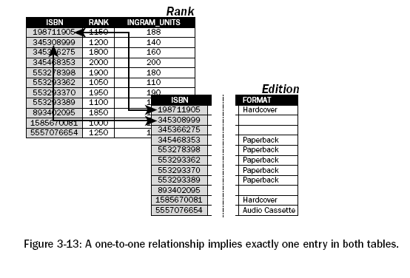
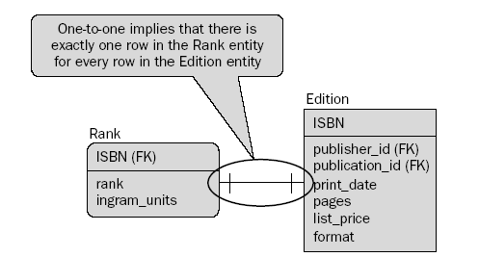

Slide 78
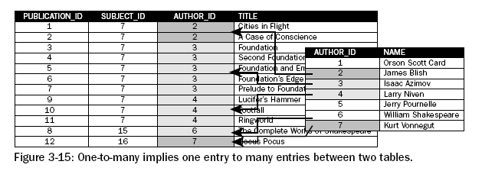
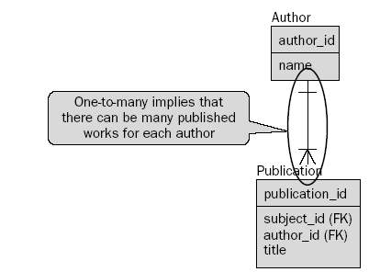

Slide 79
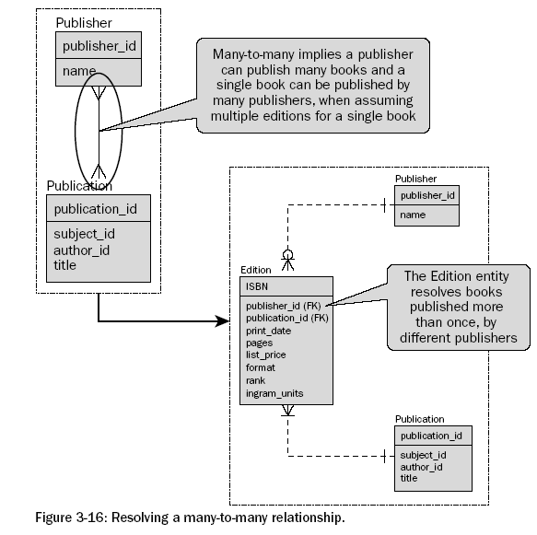

Slide 80
Strong vs. Weak Entities, and
Identifying Relationships
Strong entities
  exist independently of other types of entities
  has its own unique identifier
  represented with single-line rectangle
Weak entity
  dependent on a strong entity…cannot exist on its own
  does not have a unique identifier
  represented with double-line rectangle
Identifying relationship
  links strong entities to weak entities
  represented with double line diamond

Slide 81
Weak entity
  Existence depends on some other entity
    E.g., DEPENDENTS are weak entities; dependent on EMPLOYEE
  Has no key attributes; identified by being related (via an identifying relationship) to specific entities from another entity type (called identifying owner)
  Partial key: Set of attributes that uniquely identify weak entities related to same owner entity
    E.g., dependent name (names of dependents of same employee must be unique)

Slide 82
Primary key of weak entity: identifying owner’s primary key + partial key
Ssn is “social
security no.”
Ssn
EMPLOYEE
Name
1
DEPENDENTS_
OF
N
Name
Key = Ssn+name
DEPENDENT
Relationship

Slide 83
Another example:
Participation
constraint
Weak entity
type
Indentifying
relationship
CUSTOMER
MAKES
RENTAL
VIDEOTAPE
RENTS
Due-date
Rent-date
Payment
Partial
key

Slide 84
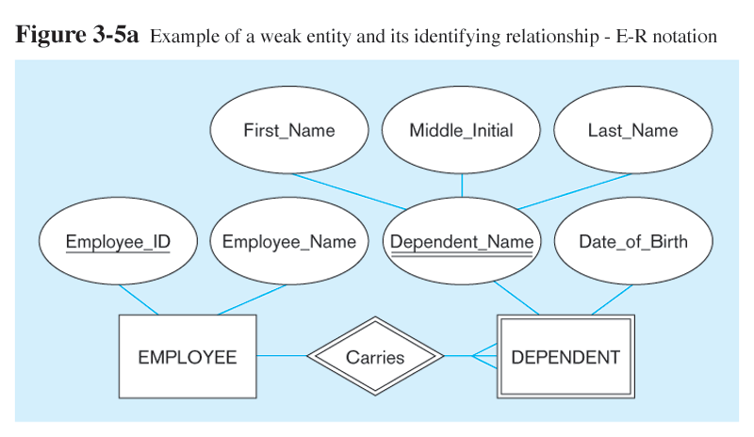
Strong entity
Identifying relationship
Weak entity

Slide 85
Associative Entities
It’s an entity – it has attributes
AND it’s a relationship – it links entities together
When should a relationship with attributes instead be an associative entity?
  All relationships for the associative entity should be many
  The associative entity could have meaning independent of the other entities
  The associative entity preferably has a unique identifier, and should also have other attributes
  The associative entity may participate in other relationships other than the entities of the associated relationship
  Ternary relationships should be converted to associative entities

Slide 86
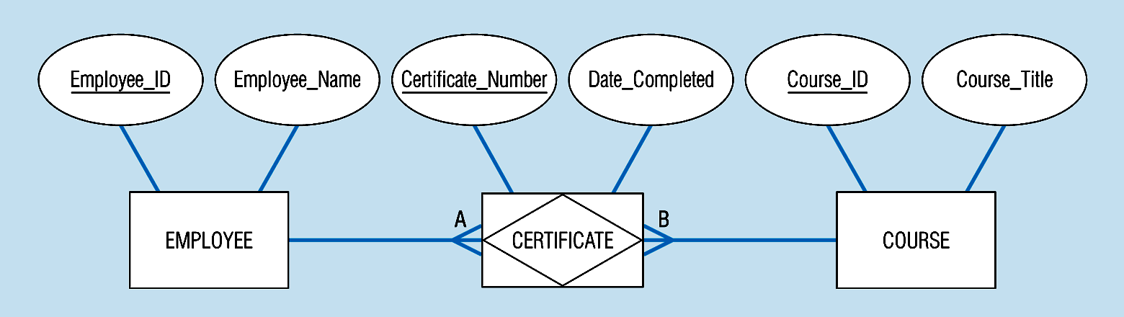
An associative entity (CERTIFICATE)
Associative entity involves a rectangle with a diamond inside.Note that the many-to-many cardinality symbols face toward the associative entity and not toward the other entities
Notes:
21

Slide 87
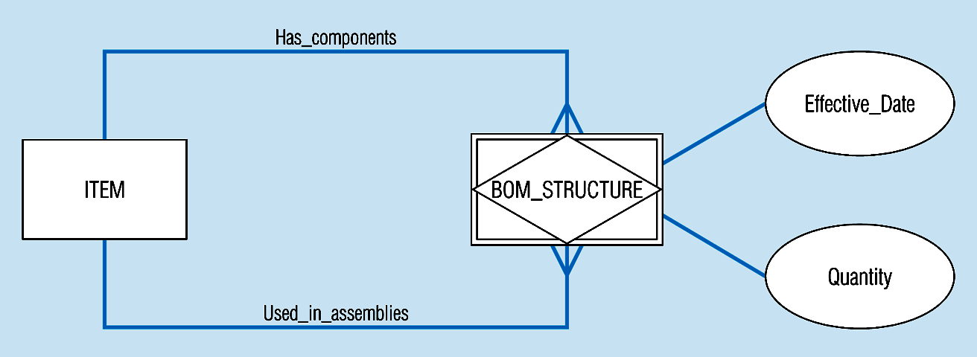
An associative entity – bill of materials structure
This could just be a relationship with attributes…it’s a judgment call
Notes:
27

Slide 88
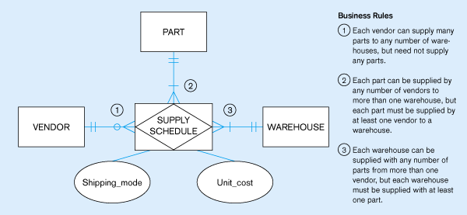
Ternary relationship as an associative entity
Notes:
36

Slide 89
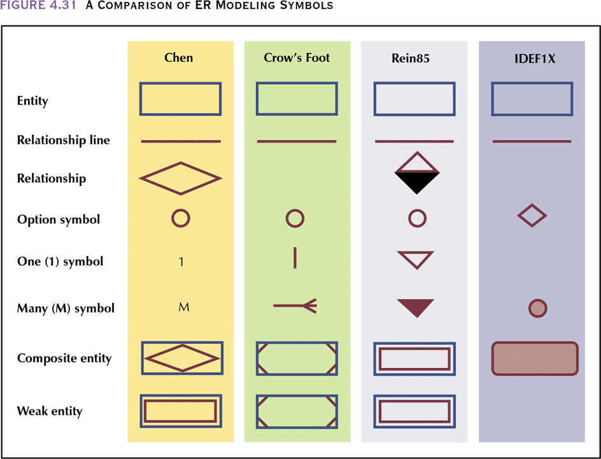
A Comparison of ER Modeling Symbols

Slide 90
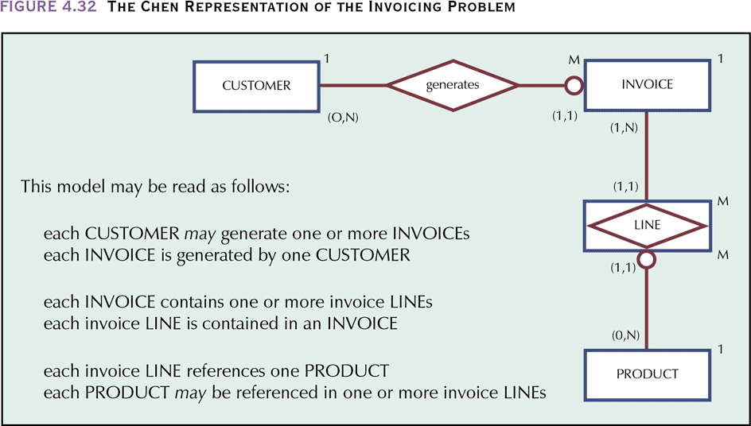
The Chen Representation of the Invoicing Problem

Slide 91
Example
Organization made up of various departments, each having a name, identifying no., and an employee who is the manager. A department may be located in different places.
Information about employees include name, identification number, birthdate, address, sex, and salary. Each employee is assigned to one department. The date the manager is appointed to a department is also tracked. Employees may be directly supervised by another employee.
Each project within the organization is controlled by a department. Employees (not necessarily from the controlling dept.) are assigned to projects.
A
B
C

Slide 92
Information about projects include project name, no., and location. Hours spent by employees on each project are also kept.
Information about employees’ dependents are kept. These include name, sex, birthdate and relationship.
D
E

Slide 93
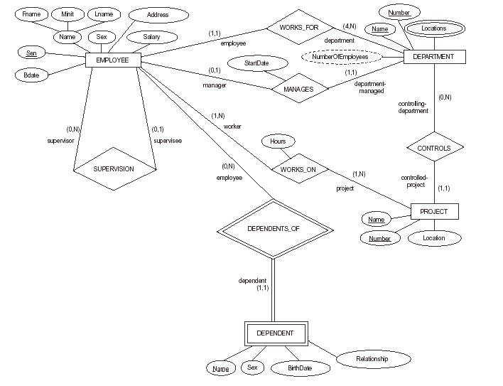
A
B
C
D
E

Slide 94
Design Decisions I
Entity versus attribute
  In general, if information contains more than just a name, entity is probably needed
  Should Address be attribute (of EMPLOYEE) or an entity (connected to EMPLOYEE by a relationship)?
    Depends on how we use Address information
    E.g., if different address for different periods are needed, then use entity

Slide 95
Relationship CONTRACT represents a STUDIO that has contracted a particular STAR in a specified FILM. If more complex, e.g., more than one studios involved - production, special effects, distribution, etc., then better to make CONTRACT an entity. The relationship between CONTRACT and STUDIO can be M to N
STAR
FILM
STAR
FILM
STAR_OF
MOVIE_OF
CONTRACT
CONTRACT
STUDIO_OF
STUDIO
STUDIO

Slide 96
Binary versus ternary
  Part-Supplier-Project relationship is another example
  Cannot replace this ternary relationship with several binary relationships; involve a quantity of P# being supplied by S# to project J#
qty
M
N
SUPPLIER
SUPPLY
PROJECT
P
PART

Slide 97
For example, given 3 entities- INSTRUCTOR, SEMESTER, COURSE:
one ternary relationship OFFERS vs. three binary relationships, CAN_TEACH, OFFERED_DURING, TAUGHT_DURING
  Ternary relationship generally represents more information than 3 binary relationships
  Relationship instance (I,S,C): instructor I offers course C during semester S
  (I,S,C) ⇒ (I,S) and (I,C) and (C,S) but reverse not necessarily true
  Decision: Include n-ary relationship and, if necessary, one or more binary relationships

Slide 98
Binary Relationships Only
TAUGHT_
DURING
Semester
Year
M
N
IName
SemName
INSTRUCTOR
SEMESTER
M
N
CAN_
TEACH
N
M
OFFERED_
DURING
COURSE
CNumber

Slide 99
TAUGHT_
DURING
Semester
Year
M
N
IName
SemName
M
N
INSTRUCTOR
OFFERS
SEMESTER
M
N
P
CAN_
TEACH
N
M
OFFERED_
DURING
COURSE
CNumber

Slide 100
THE END

